Slide 1
Demand Prediction: EDA
10.13.2017
Nirmal Budhathoki
Garrett Cheung
Jillian Jarrett
Toby Moreno
Orysya Stus
Notes:
Jill

Slide 2
Project Objective
Providing valuable statistics, identifying data issues, and creating visualizations with the end goal of predicting book sale demand.
Notes:
Jill

Slide 3
General Questions
How will this data help us predict demand?
What exactly is our target? By which metric are we going to predict book demand?
Region
Time
Genre
All of the above?
How are our features related to one another?
Which features are indicators in predicting our target? Which aren’t?
What features can we engineer to better predict our target?
Notes:
Jill

Slide 4
Overall Approach
Note: This is tentative, other group feedback may alter process.
Milestone I | Milestone II | Milestone III | Milestone IV
Data dictionary Preliminary statistics Histograms for columns distributions | Visualize trends, correlations, and important relations Text analysis | Provide directions for feature engineering Machine learning recommendations | Determine if machine learning predictions and findings are in agreement with EDA
Notes:
Jill

Slide 5





Tools
Notes:
Jill

Slide 6
Data Dictionary
Table | Data Source | Description
calendar | PostGreSQL | Master calendar from 1/1/1950 - 12/31/2050 including holidays and DoW
campaigns |  | Discounts/Free Shipping promotions
customers |  | Customers and which household they belong to
orders |  | Purchases by each customer
orderlines |  | How Amazon distributed/shipped the purchased items
products |  | Books, prices, ASIN, category, in stock
reviews |  | Reviews, reviewer name, score, time
subscribers |  | Subscribers (dealer, mail, store, chain), monthly fee, start/stop dates
zipcensus |  | Comprehensive census broken down by zip code
zipcounty |  | Zip codes and their Geographic/Demographic data
Notes:
Garrett

Slide 7
Data Dictionary
Table | Data Source | Description
reviews | AsteriskDB | Json based repository for reviews by category
Reviews | Solr | Searchable reviews in text format.
Notes:
Garrett

Slide 8
PostGreSQL Tables - Preliminary Stats
For each table access the following documents:
Data.txt: data shape, data type of each column, count of nominal, numeric, and datetime attributes
nominal_stats.csv: unique and null count
numeric_stats.csv: mean, min, max, std, percentiles
datetime_stats.csv: min, max, most frequent date
columnname_val_counts.csv: for a specific nominal column name a count of the unique values
columnname.png/columnname_logscale.png: normal and log scale histograms for numeric attributes
Find preliminary stats here: https://github.com/mas-dse-jejarret/DSE203_Demand_EDA/blob/master/PostGreSQL_Tables_PreliminaryStats.zip
Notes:
Orysya

Slide 9
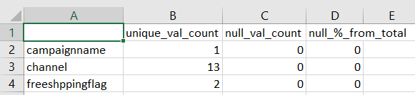
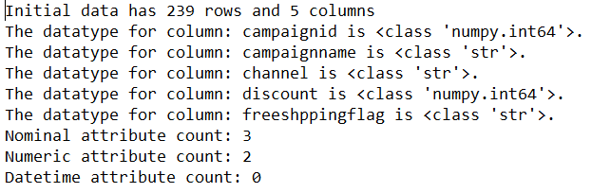
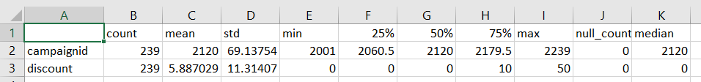
Example: campaign table
nominal_stats.csv
Data.txt
numeric_stats.csv
Find preliminary stats here: https://github.com/mas-dse-jejarret/DSE203_Demand_EDA/blob/master/PostGreSQL_Tables_PreliminaryStats.zip
Notes:
Orysya

Slide 10
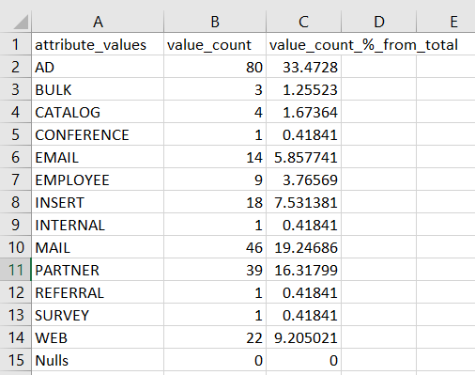
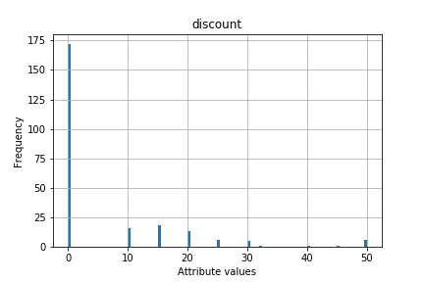
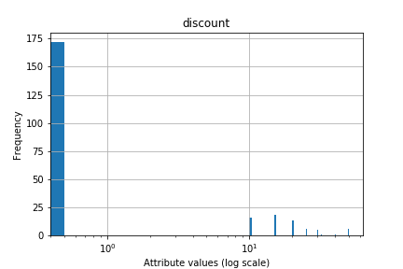
Example: campaign table
channel_val_counts.csv
discount.png
discount_logscale.png
Find preliminary stats here: https://github.com/mas-dse-jejarret/DSE203_Demand_EDA/blob/master/PostGreSQL_Tables_PreliminaryStats.zip
Notes:
Orysya

Slide 11
Asterix Data - Preliminary Stats
Notes:
Nirmal

Slide 12
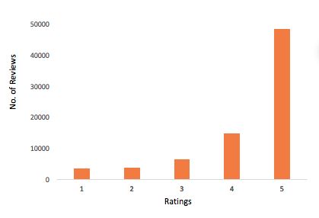
Reviews Data
Total Reviews: 77,164
Total Unique Reviewers: 69,729
Missing values: 21 (Reviewer's Name)
Average Ratings from Reviewers= 4.3
Total unique products: 4040
Each product has 19 reviews
Notes:
Nirmal

Slide 13
How can we use Reviews data ?
Historical reviews are very important for predictive models (e.g. Predicting demand for a new book can be compared against similar books sold in past)
Negative reviews can also be valuable (e.g. price adjustment)
Sentiment analysis
Challenges:
The review data is not yet linked to the product data or customer data
Finding the product attributes to compare and find similarity against books
Notes:
Nirmal

Slide 14
Classification/Category Data
[ { "uid": "Children's Books", "count": 793 }
, { "uid": "Christian Books & Bibles", "count": 288 }
, { "uid": "Computers & Technology", "count": 435 }
, { "uid": "Crafts, Hobbies & Home", "count": 347 }
, { "uid": "Engineering & Transportation", "count": 272 }
, { "uid": "Gay & Lesbian", "count": 39 }
, { "uid": "History", "count": 384 }
, { "uid": "Law", "count": 144 }
, { "uid": "Literature & Fiction", "count": 428 }
, { "uid": "Medical Books", "count": 288 }
, { "uid": "Mystery, Thriller & Suspense", "count": 59 }
, { "uid": "Religion & Spirituality", "count": 534 }
, { "uid": "Science & Math", "count": 432 }
, { "uid": "Sports & Outdoors", "count": 233 }
, { "uid": "Travel", "count": 651 }
, { "uid": "Arts & Photography", "count": 389 } ]
Notes:
Nirmal

Slide 15
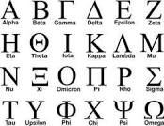
Solr Data - Preliminary Stats
Notes:
Toby

Slide 16
Solr Data Review
Could be a useful platform for exploring large sets of text data
Host Target Location should be a cloud infrastructure
Manual data integration requires converting data to XML first
Is there Real-time Twitter Feed Configuration?
Data Access requires simple HTTP protocol (built-in Java client support)
May require multiple transformations
Tokenization / TFIDF
POS tagging / Stemming and Lemmatization
Derived sentiment analysis could be used to project demand
Still a Working Progress
Too Early to tell if it would be useful
Collaborating with other stakeholders is critical
Notes:
Toby

Slide 17
Next Steps
Work with Integrated Schema and Justification Team to review preliminary statistics.
Work with Query capability and Learning Team to create the necessary views/tables for us to use.
Discuss and create meaningful visualizations of trends with the suggestions from Machine Learning Team.
Notes:
Toby

